Slide 1
A Century of Turmoil
Chapter 14
Section 4

Slide 2
Church Divided
Pope and King Collide in 1300 (King wins)
Pope Clement V
  Moved from Rome to Avignon, France
  Weakened the Church

Slide 3
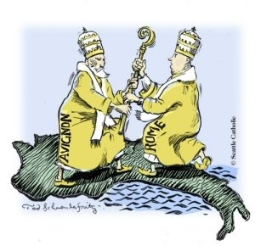
The Great Schism
College of Cardinals
  Chose an Italian pope
      Bad choice
  French cardinals elected another pope
Main issue
  Three popes: French and Italian
  Who was the REAL pope?

Slide 4
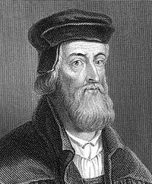
Questioning the Church
John Wycliffe
Said Jesus Christ, not the Pope, is the head of the Church
Bible alone = final authority
Church worldliness – more concerned with possessions & wealth and less about spirituality

Slide 5
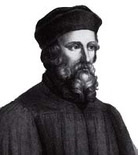
Questioning the Church
Jan Hus
Authority of Bible higher than authority of Church
Burned at the stake for heresy (heretic)

Slide 6
Fifteenth century fresco
Dance of death
Grim Reaper visits everyone

Slide 7
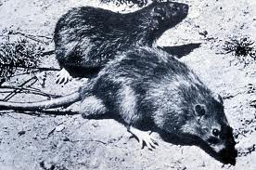
Bubonic Plague Strikes
Known as Black Death
1/3 of Europe dies (~25 million)
Origin – 1347 came on a merchant ship from Asia via rats (did not know this until after the fact)
Blamed the Jews and massacred them

Slide 8
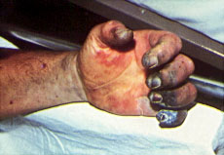
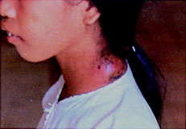
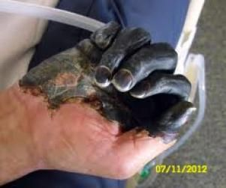
Symptoms
Septicemia Form:
almost 100% mortality rate.
Bubonic

Slide 9

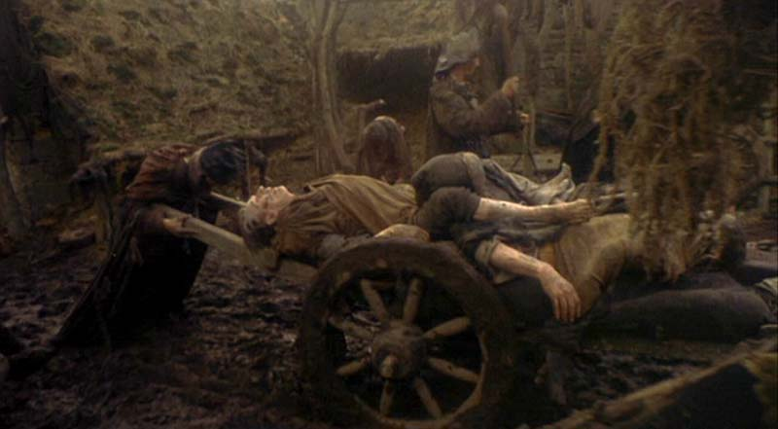
HOW BAD YOU SAY????
Half the population died in Florence in 6 months.
50,000 bodies were buried in one grave in London.
In Vienna 1200 people died in one day
The Pope Consecrated the Rhone River, so people could throw bodies into it.

Slide 10
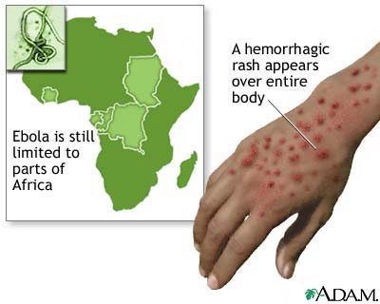
What are some modern day plagues?
Aids?
Swine Flu?
Avian Flu?
Hepatitis?
Ebola?

Slide 11
Effects of the Bubonic Plague
Economically:
  Population decrease = less workers
  Trade decline
  Price rose
Church:
  Loses prestige
Medieval Society:
  Collapse of feudal society was sped up
  Disrupted all aspects of the society

Slide 12
Songs
Ring around the rosy,
Pockets full of posy,
Ashes, ashes
We all fall down.

Slide 13
Ring around the rosie
“Ring around the Rosie”
  Refers to a red mark, supposedly the first sign of the plague
“A pocket full of posies”
  Refers to sachets of herbs carried to ward off infection
“Ashes, ashes”
  Either a reference to the cremation of plague victims or to the words said in the funeral Mass..."Ashes to ashes, dust to dust."
“We all fall down.”
  Death: the plague was not selective in its victims; both rich and poor, young and old, succumbed.

Slide 14
Spring
1348

Slide 15
Summer
1348

Slide 16
1349

Slide 17
1350

Slide 18
1351-2

Slide 19
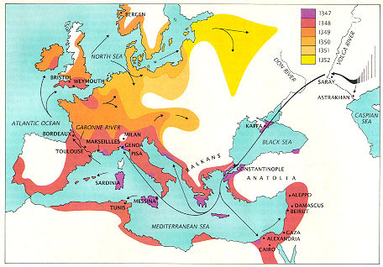

Slide 20
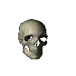
Bubonic Plague Art

Slide 21
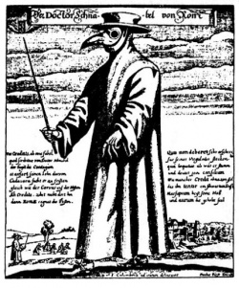
The beak is a primitive gas mask, stuffed with substances thought to ward off the plague.

Slide 22
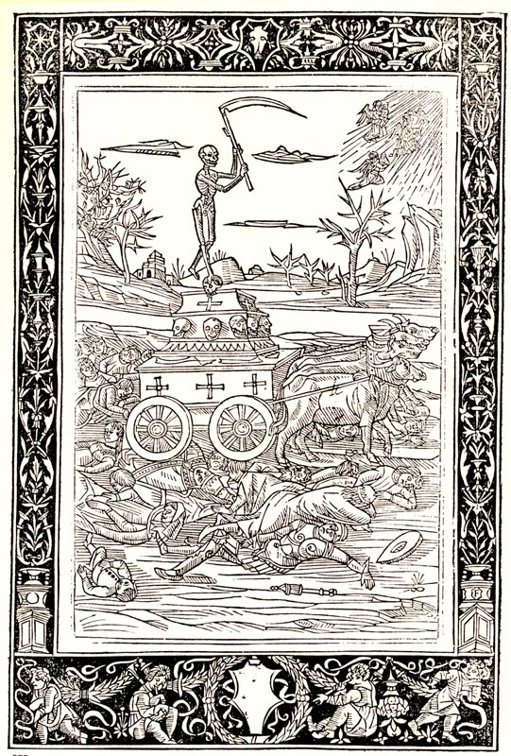

Slide 23
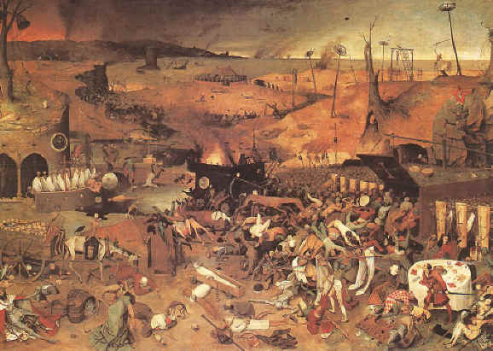

Slide 24
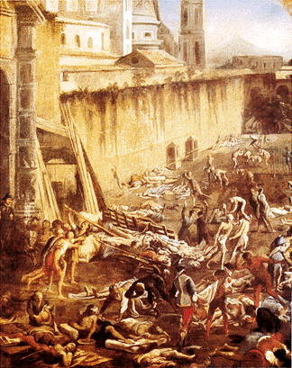

Slide 25
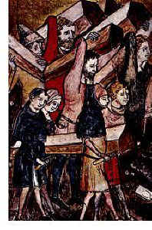

Slide 26
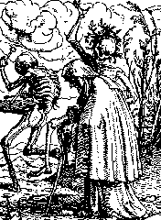

Slide 27
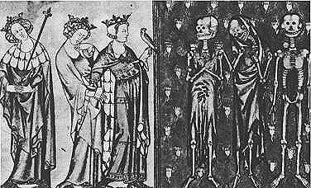

Slide 28
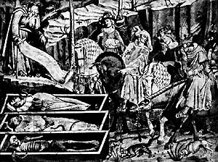

Slide 29
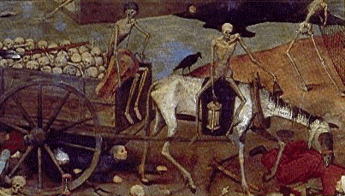

Slide 30
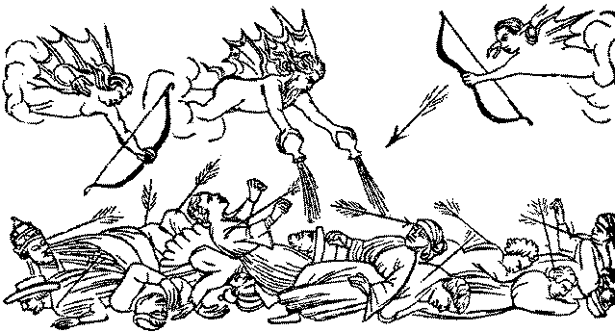

Slide 31
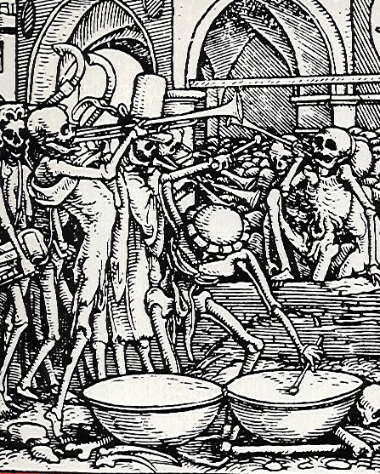

Slide 32
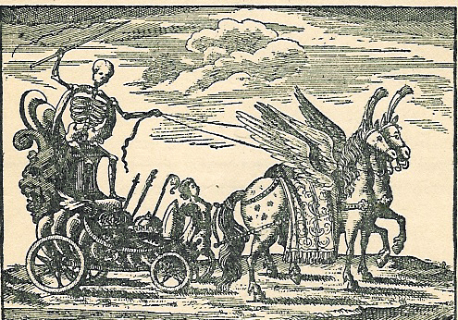

Slide 33
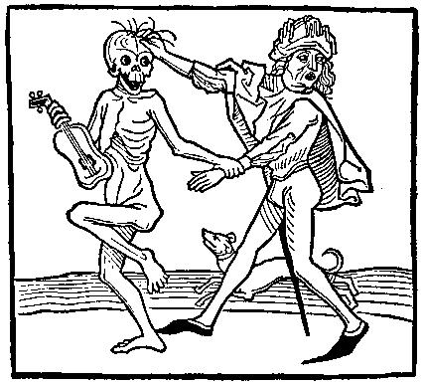

Slide 34
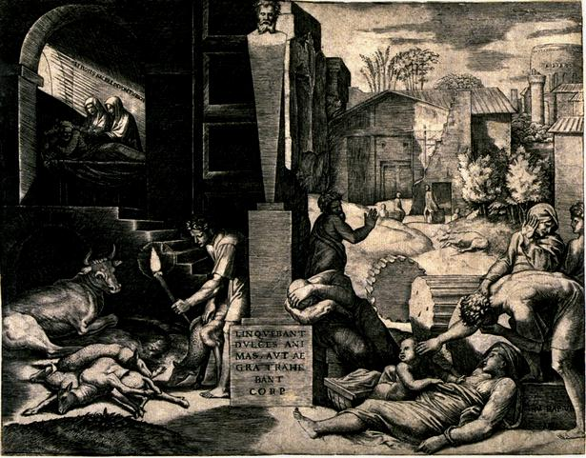

Slide 35
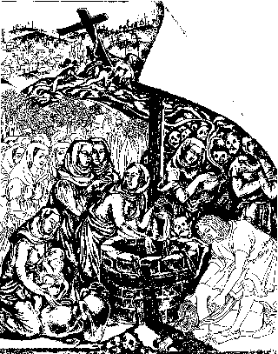

Slide 36
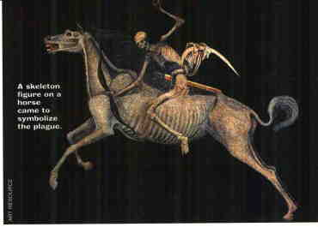

Slide 37
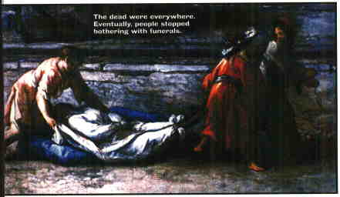

Slide 38
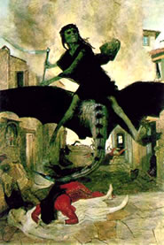

Slide 39
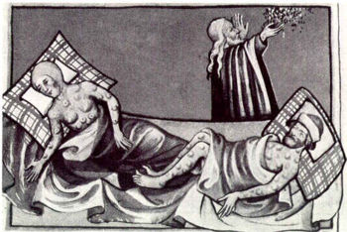

Slide 40
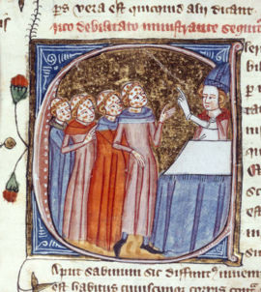

Slide 41
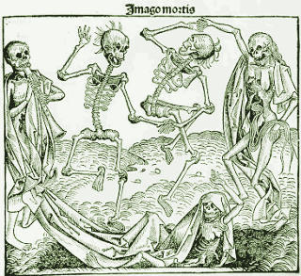

Slide 42
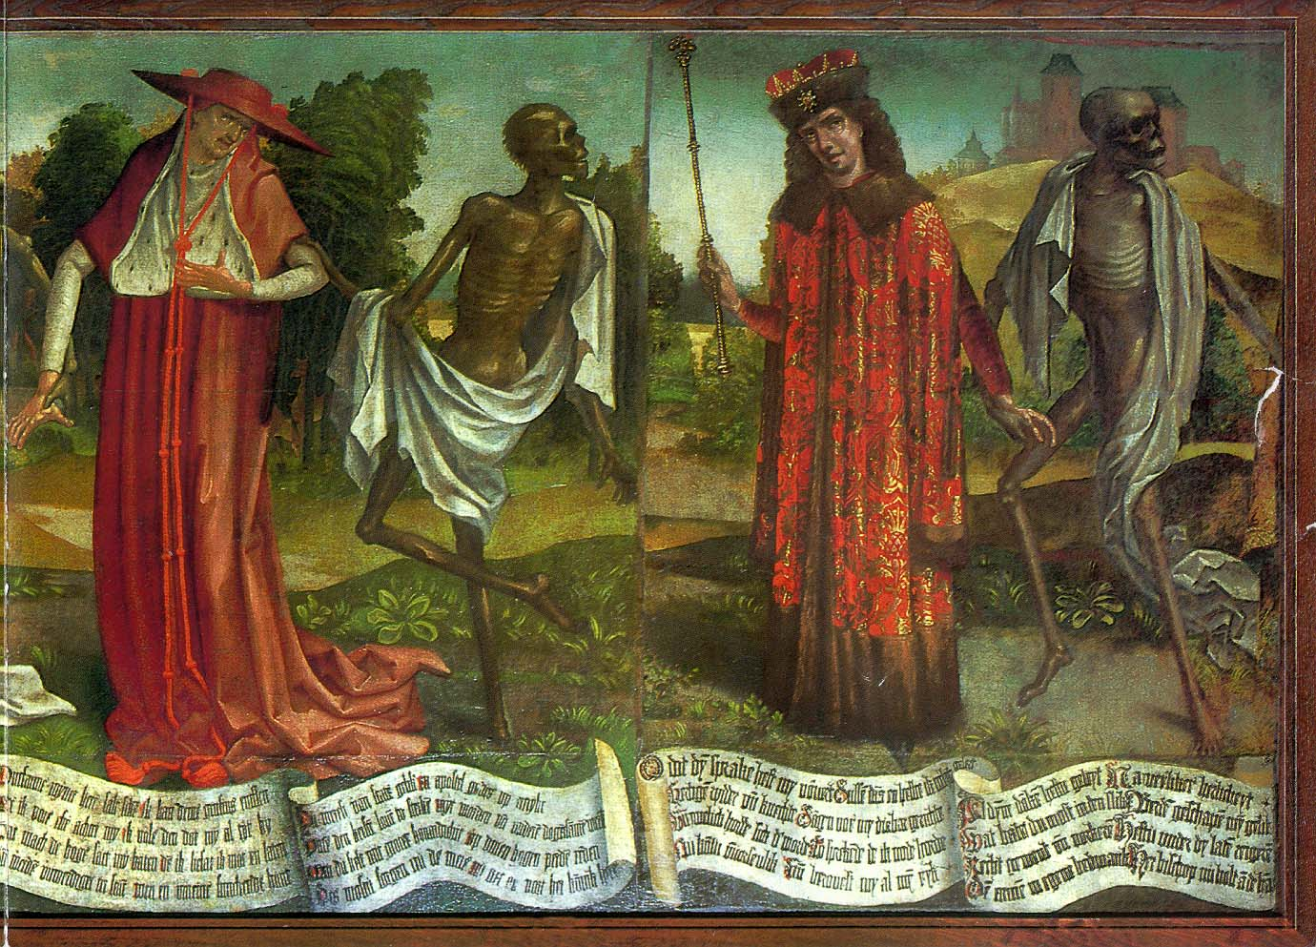

Slide 43
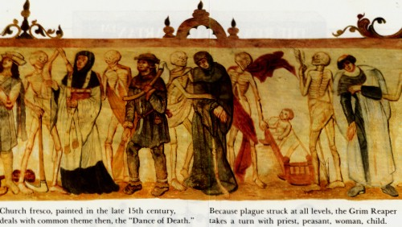

Slide 44
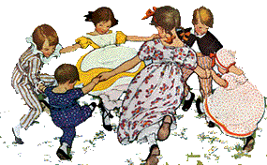

Slide 45
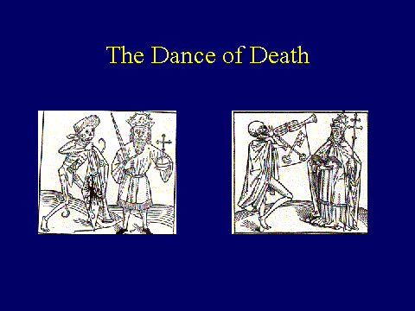

Slide 46
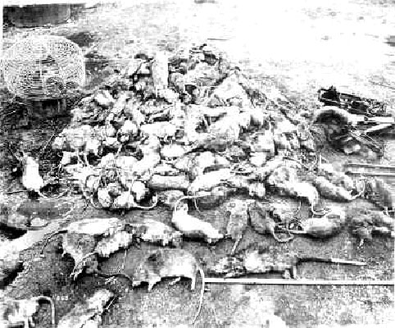

Slide 47
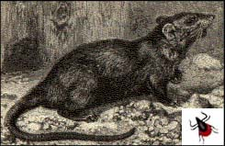

Slide 49
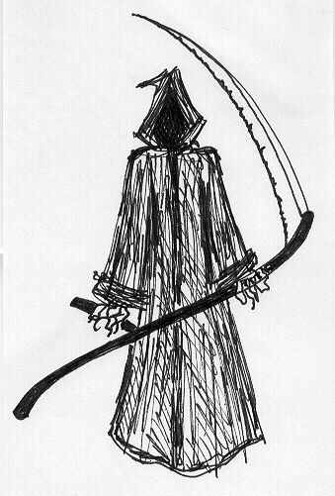
ashes, ashes, we all fall down...

Slide 50
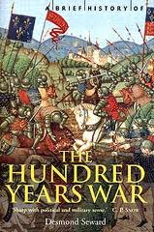
Hundred Years War: 1337-1453
France v. England fought for French throne
English won battles with longbow, but France won the war
1453 – 1337 = ???

Slide 51
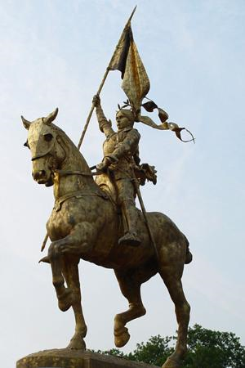
Joan of Arc
Believed Charles VI’s son was the rightful king
Siege of Orleans
  She helped the French end the siege and came out victorious
  Charles crowned king = Joan was captured
Turned over to the Church
  Marked as a witch and heretic
  Burned to death at the stake

Slide 52
Effects of 100 Years War
Raised power and prestige of French Monarchy
Nationalism
  King is more than a feudal lord → national leader
End of wars = end of Middle Ages

